Slide 1

All Years – Human Rights
RFK HUMAN RIGHTS UK
Session 5
Speak Truth To Power

Slide 2
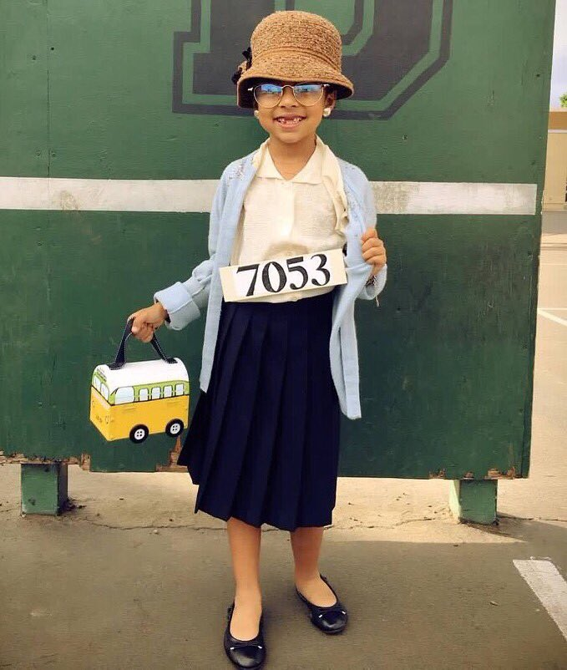

ACTIVITY:
Dress like an activist.
Think like an activist.
Be like an activist.

Slide 3
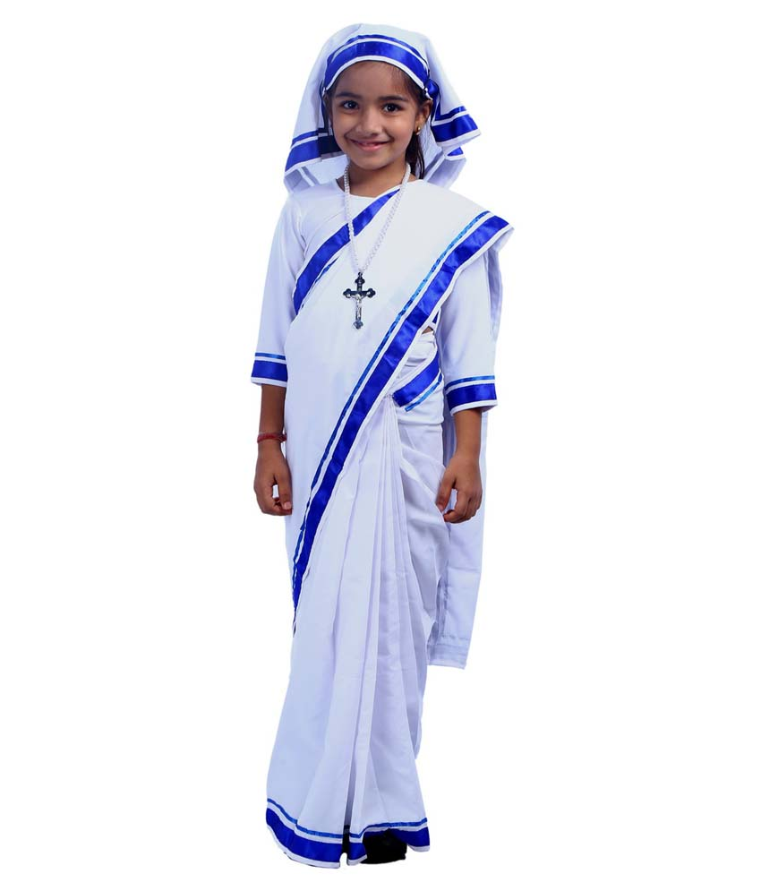
ACTIVITY 1:
DRESS: You will dress as your favourite Human Rights hero.

Slide 4
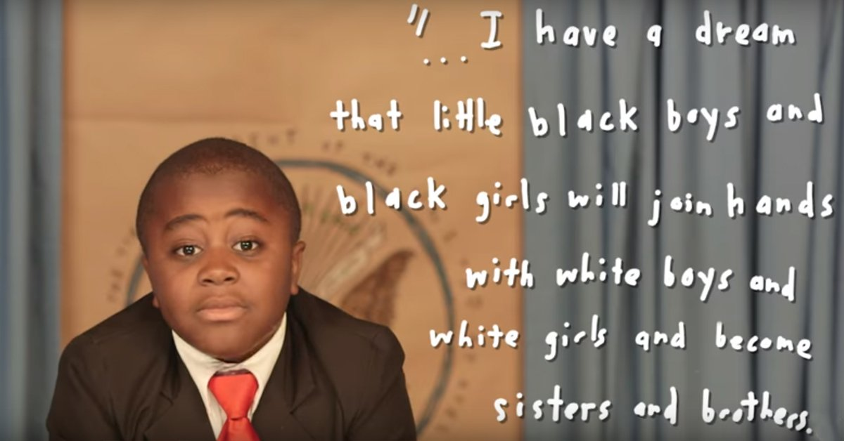

Slide 5
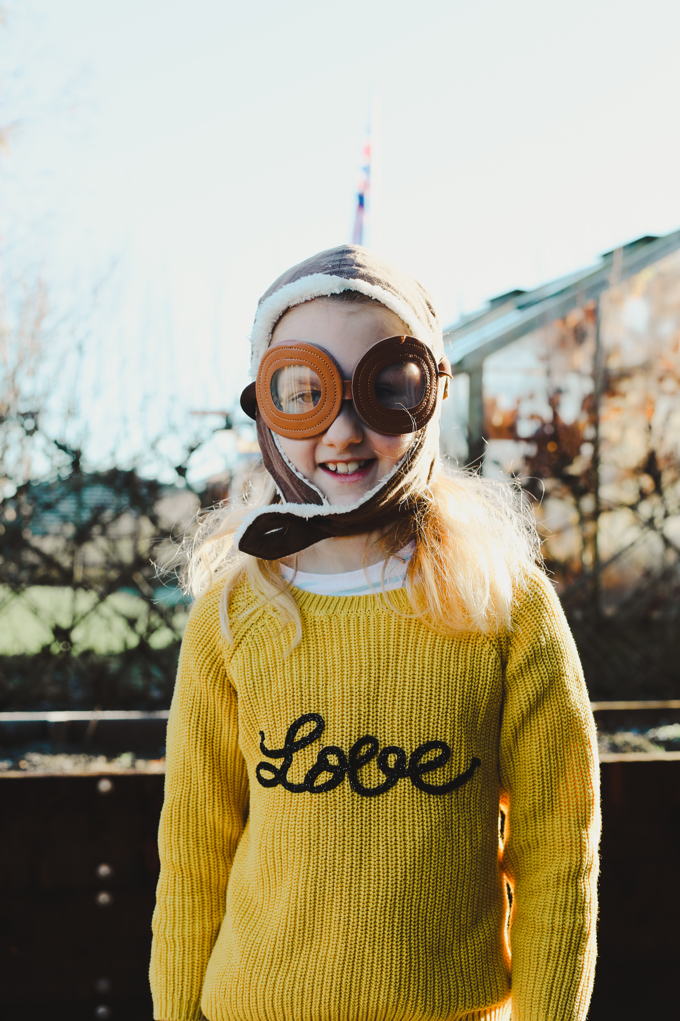
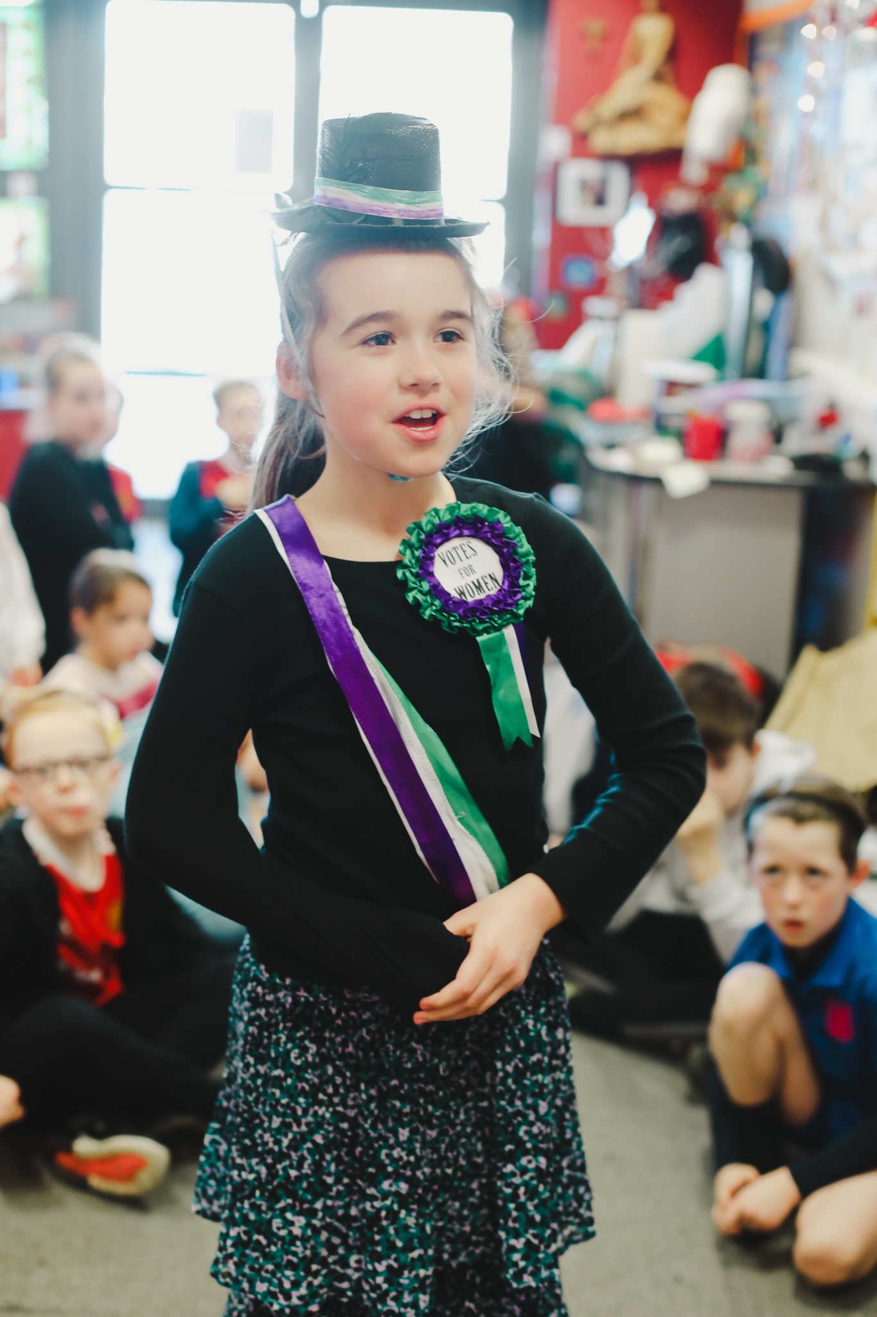

Slide 6
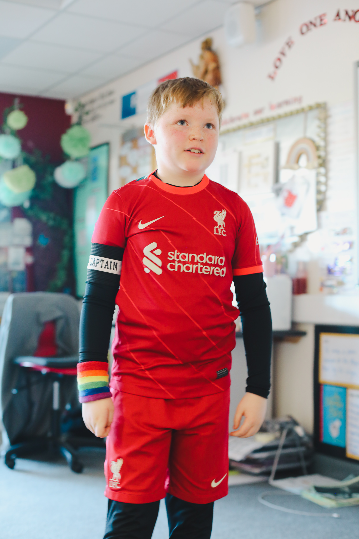
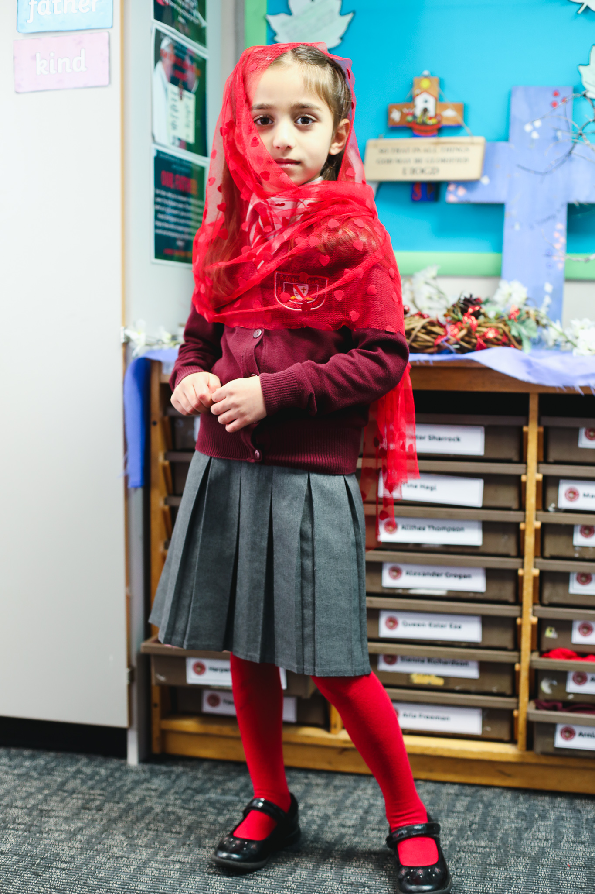

Slide 7
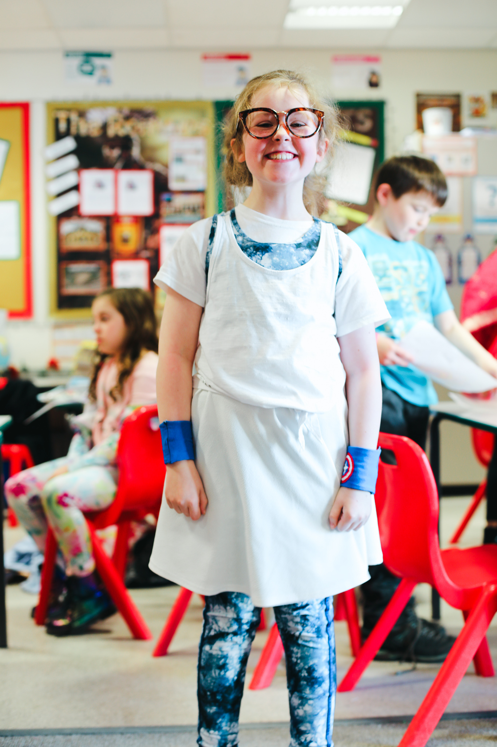
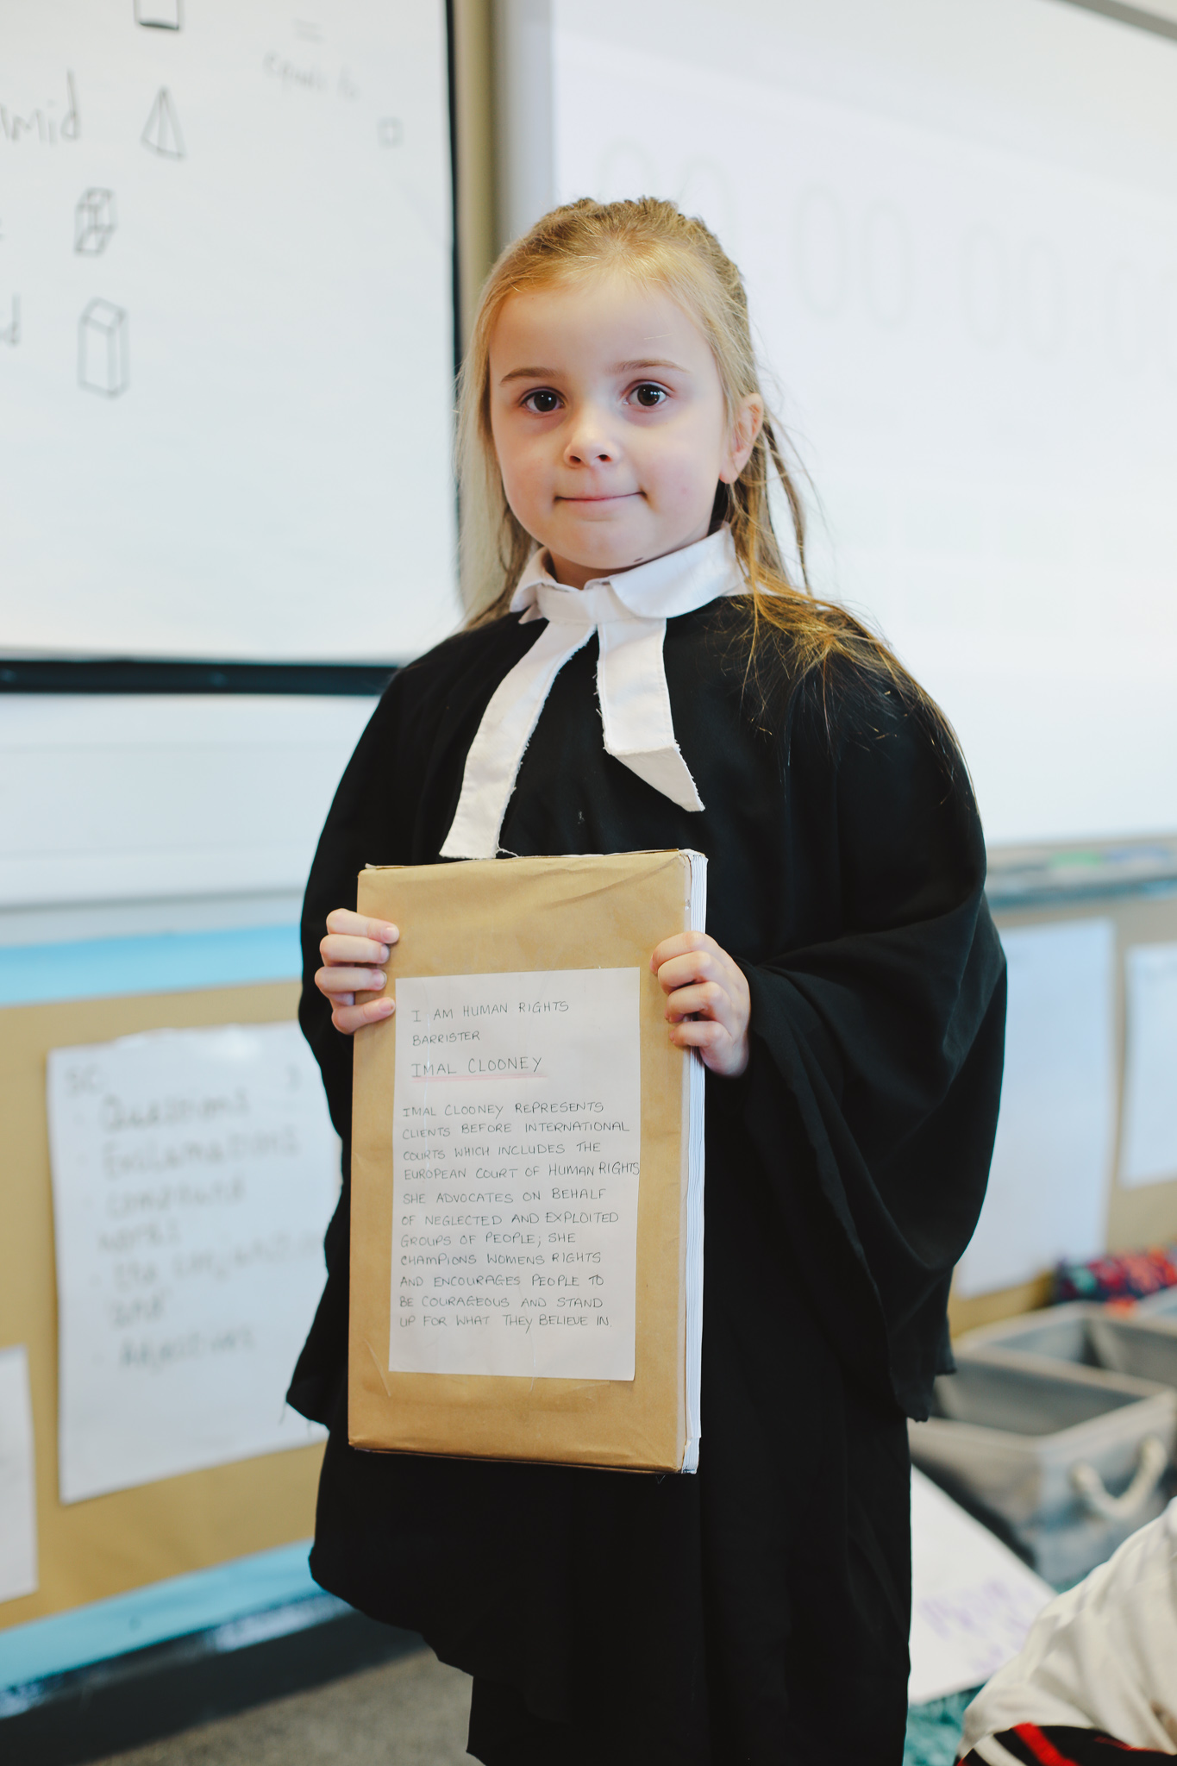

Slide 8
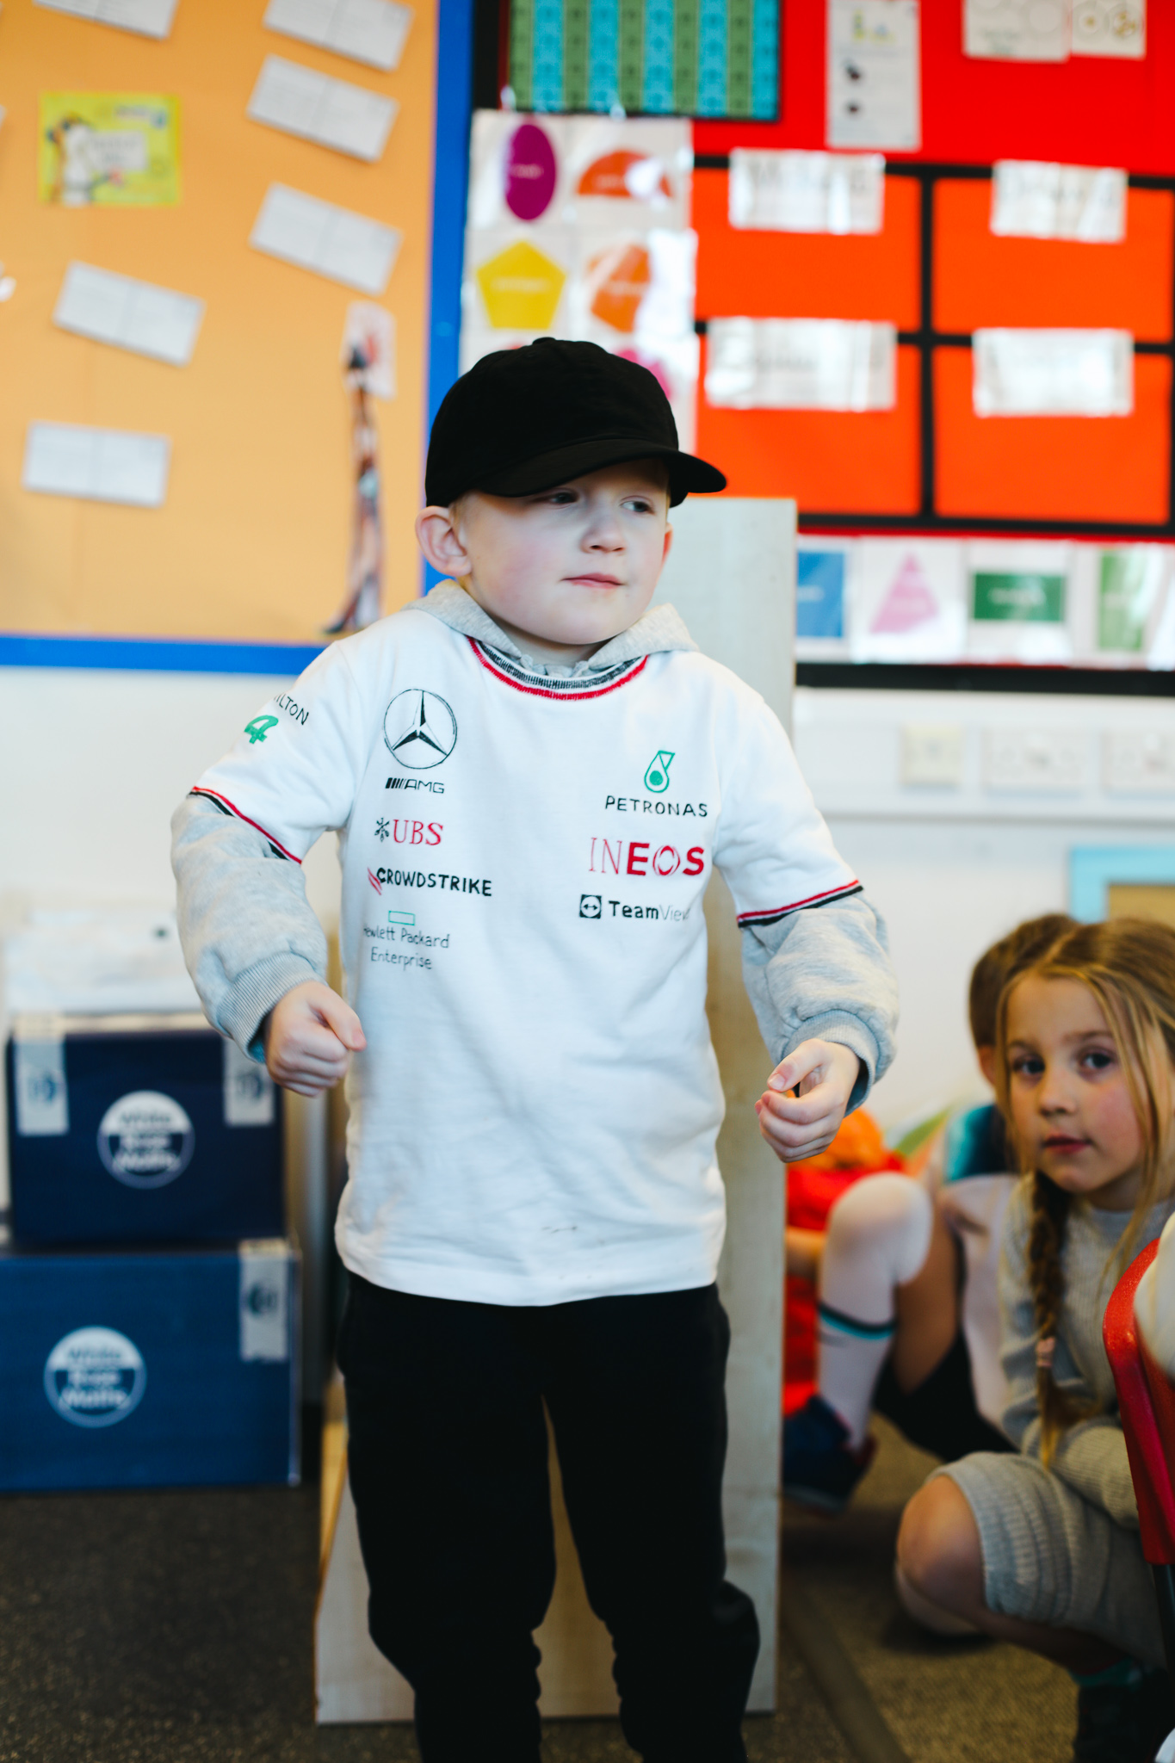
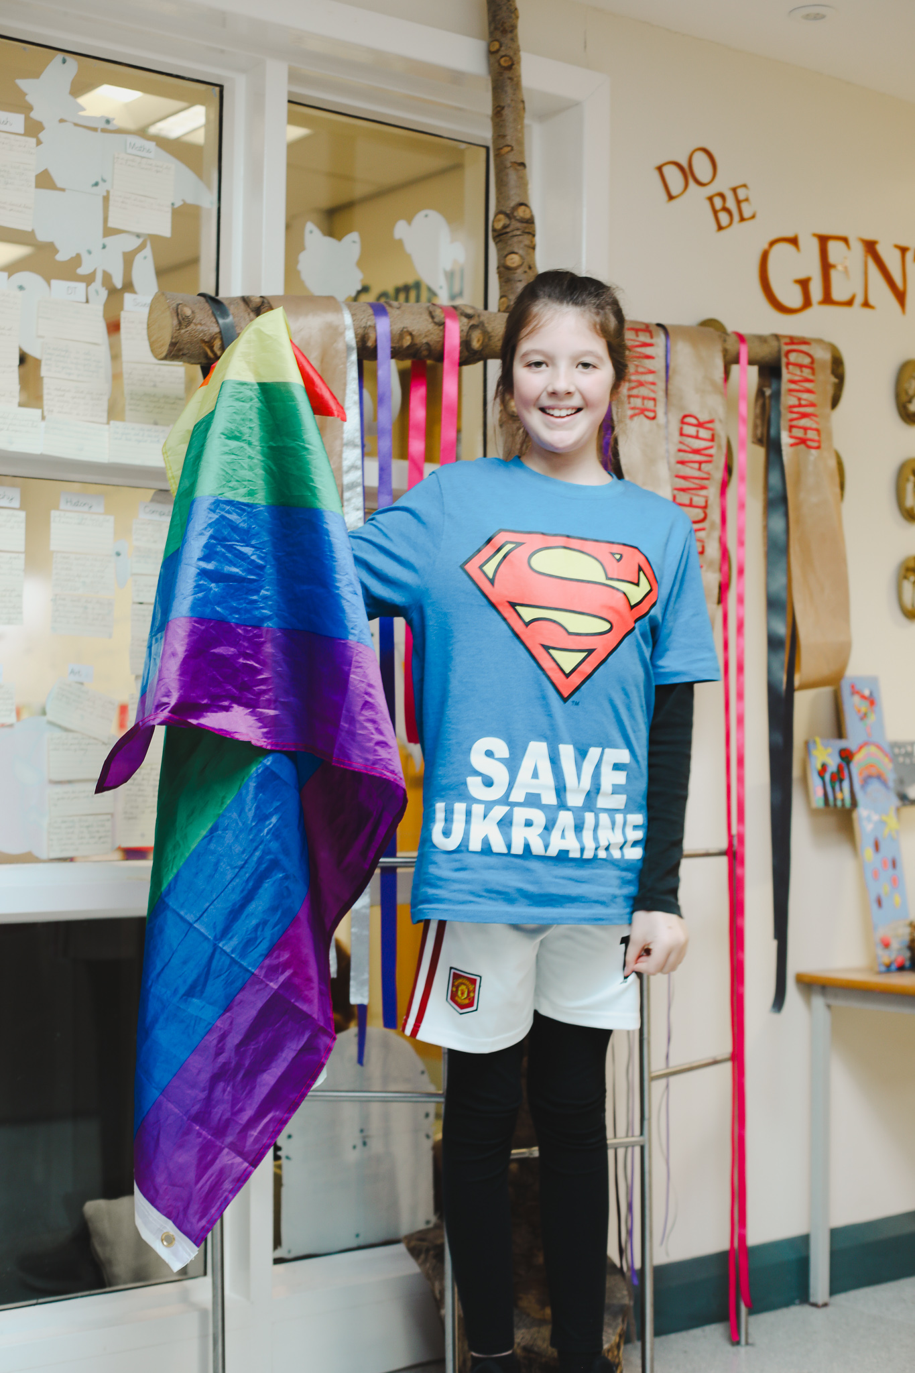

Slide 9

ACTIVITY 2:
THINK: You will create a Human Rights placard. Write your pledge on a large piece of card. What is your mission and how will you be a change maker?

Slide 10
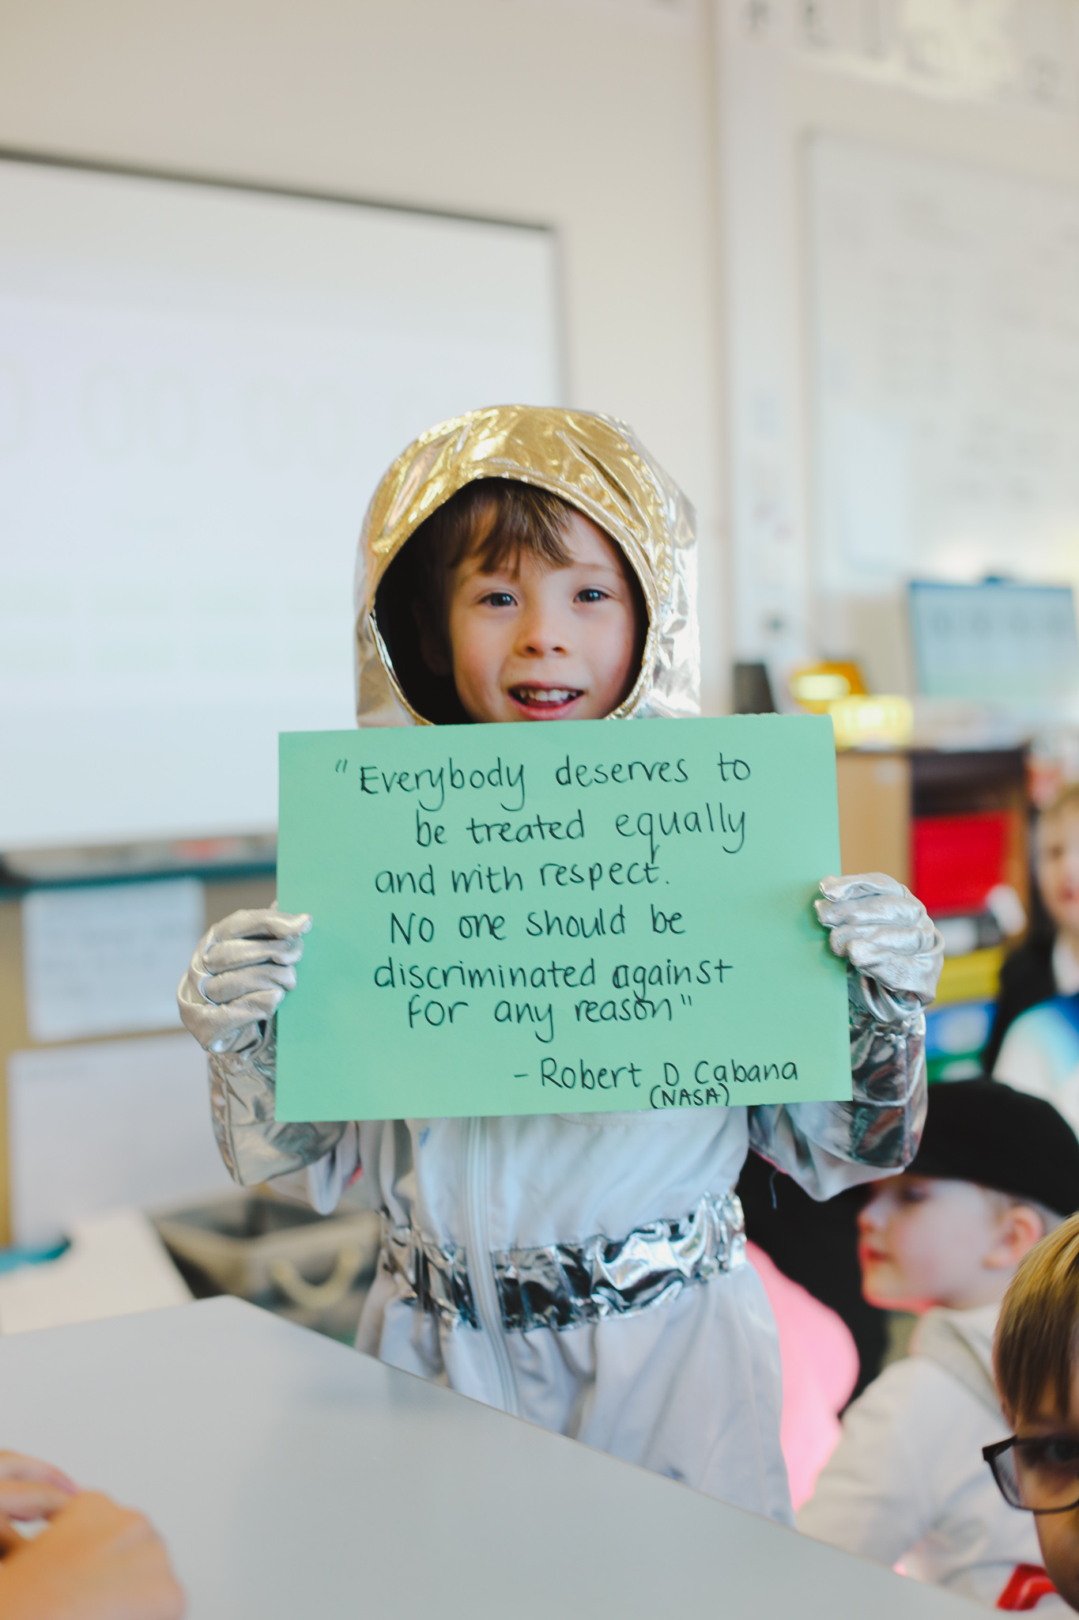
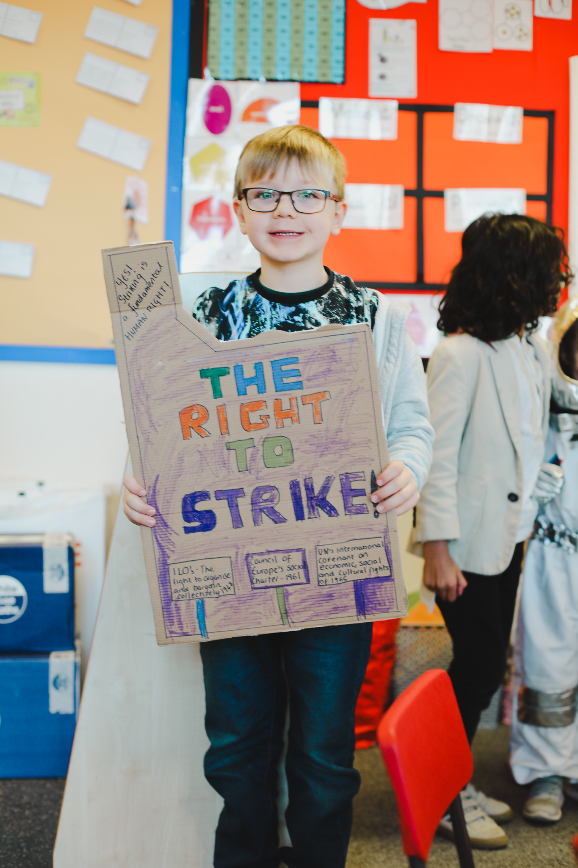

Slide 11
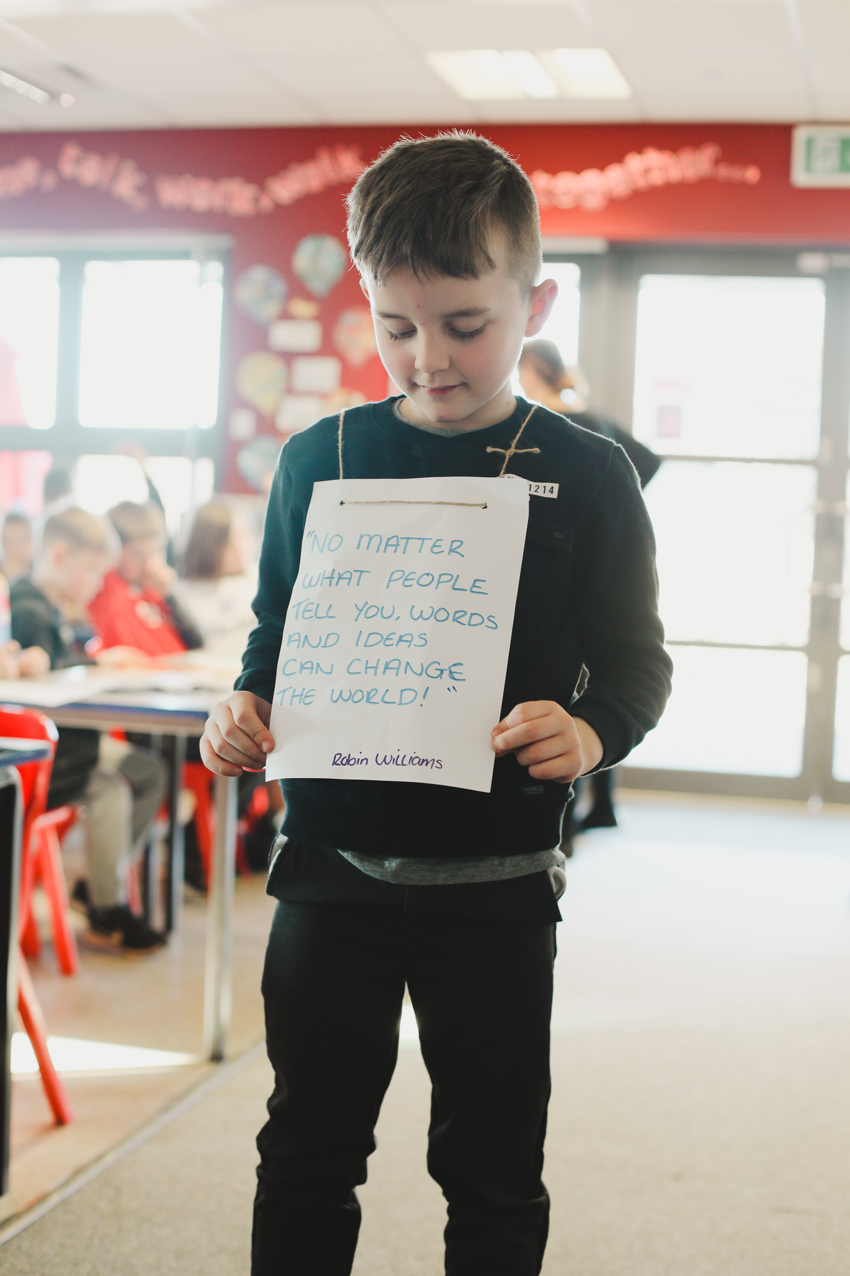
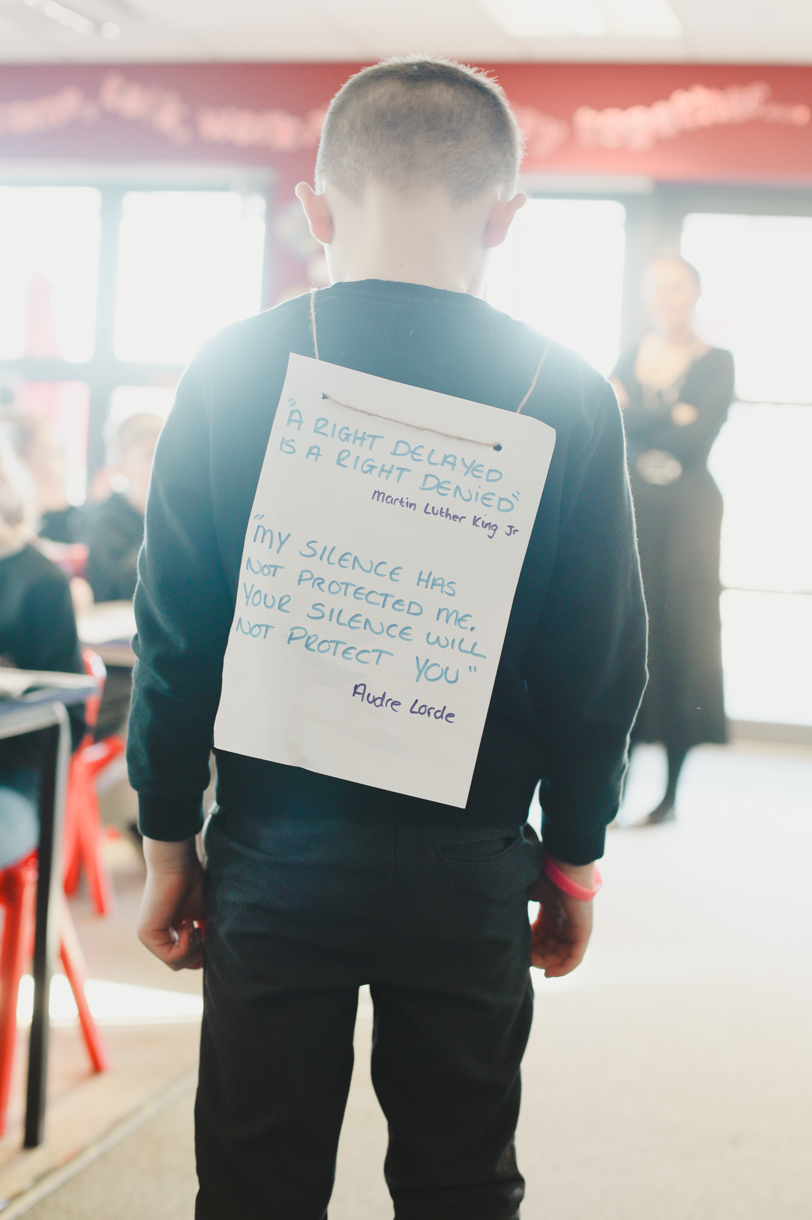

Slide 12
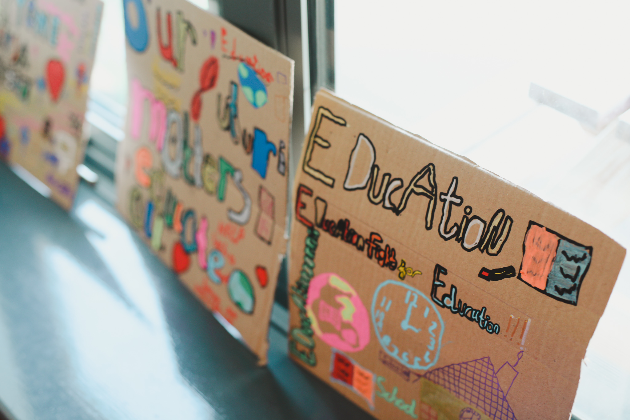
ACTIVITY 3:
BE: Be an Activist.
Take part in a protest walk through School or deliver a presentation to your class

Slide 13
ACTIVITY 3:
BE:
Evaluate your learning
WWW – What Went Well
EBI – Even Better If

