Slide 1

Why Teach Human Rights?
RFK HUMAN RIGHTS UK
A toolkit for action
Speak Truth To Power

Slide 2

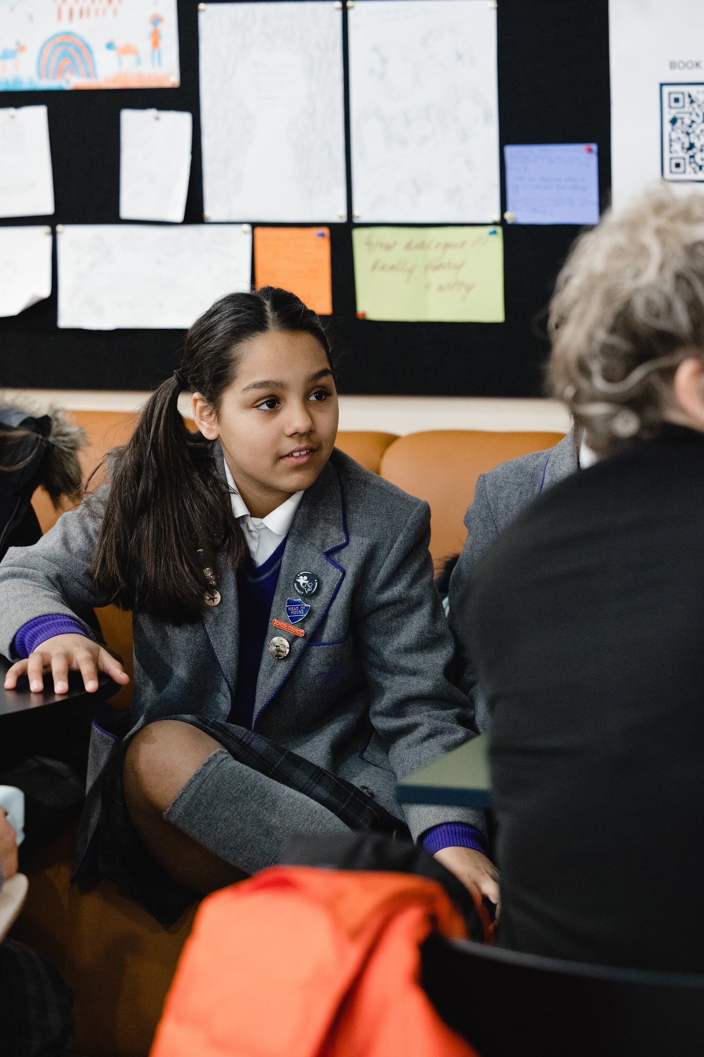

Is there room in our curriculum?
Human Rights education can fit into:
English PSHE Curriculum – core themes of Health and Wellbeing; Relationships; Living in the Wider World.
Welsh Curriculum – Humanities
Scottish Curriculum for Excellence – Social Studies
Northern Ireland Curriculum – The world around us; environment and society.
British Values – democracy, rule of law, individual liberty, mutual respect and tolerance for those of different faiths and beliefs.
Spiritual, Moral, Social and Cultural Development.
Oracy.

Slide 3
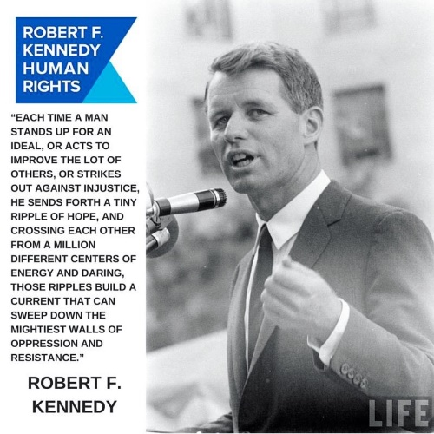
Who are we?
Senator Robert F Kennedy was a civil rights activist in the USA. He was assassinated in 1968 during his campaign to be President of the United States.
His daughter, Kerry Kennedy, set up a foundation in his name to continue his fight to make human rights a reality.
In 2019 RFK UK was born to support the work of the foundation. There are branches in Greece, Switzerland, Italy, Spain and USA.
We developed our education programme and worked with a group of primary and secondary schools in the North West of England to pilot the work. In 2022 we strengthened our schemes of learning with the support of practising school leaders. We aim to create the next generation of change makers and provide young people with the power and confidence to make a difference.

Slide 4

How can Human Rights Education support our school?
Benefits to children and adults

Slide 5
What does it do?
By providing an anchor based in international human rights, schools have found that they can frame their conversations around tricky subjects in a language which is non-judgmental, open and reflects British law.

Slide 6

Human Rights in a Primary School - example
A Faith School in the North West wanted to ensure pupils had an understanding of different types of relationships including LGBTQ+.
This can be tricky!
At the time there was significant misconceptions on social media about what schools were teaching during Relationships, Sex and Health Education.
The team framed the education around LGBTQ+ through their Human Rights Education programme helping children in Year 6 to understand how LGBTQ+ communities fought for their rights globally and in the UK. They looked at the articles of Human Rights and discussed if the LGBTQ+ communities rights were being met prior to law change and explored the abuse people face.
This helped the children to understand more about different communities, provided a language they could discuss this appropriately and helped parents to understand how the material was taught. This meant that there was very little push back from parents.

Slide 7
Human Rights in a Secondary School - example
As many schools have faced, the arrest of a prominent social media influencer for human trafficking and rape promoted much debate and young people wanting to discuss this case in detail. This can be difficult! Even more so when young people may use shock and awe in their opinions and the power of the peer group can shape conversations.
Through the Human Rights Education programme, the team were able to address this without glamourising an individual or providing an unnecessary debate about an individual.
The team went back to the articles of Human Rights and explored the case through the lens of women and girls human rights to be treated equally particularly in relation to specific articles (3-7). It meant that the teachers didn’t pass judgment on the case; rather they were able to address the impact of human rights abuses if a woman was held without liberty and security of person.
It did not stop some young people still wanting to express their opinions on the individual and their guilt; but it created a more powerful culture where the majority recognised the importance of identifying modern slavery and trafficking and why in a school environment, language should be modified so that the rights of others were respected.

Slide 8
Benefits to children

Slide 9
Benefits to children
Children make mistakes. Sometimes they express opinions in language that is not matured and can cause offence.
Their views are formed from a variety of sources including:
Immediate (home, family, peers, neighbourhood)
Institutional (youth groups, religious)
Serendipitous (random personal experiences)
Media (online, main stream, echo chambers)
Human Rights Education doesn’t seek to tell someone what to say, do or think. Instead it explains why some things happen and supports children to make positive choices in their responsibilities towards others.
It also demonstrates to children how they can make a difference to their community and provides them with examples of what has occurred before.

Slide 10
Benefits to adults

Slide 11
Benefits to adults
Flashpoints can occur in schools from - sometimes the most innocuous incident. Whatever position you have in school, it can have an impact on adults’ wellbeing and ability to be able to teach, lead or support.
Through teaching Human Rights, the adults in the building can go some way to making sure their own personal biases and opinions are not at the forefront. It can allow you to objectively deal with ‘wicked’ problems that come into school; it can allow you to have a firm foundation so that when a difficult situation arises, the school community is secure in its approach; it can help us as adults negotiate the complex world in a school where nuance is of ultimate importance but the solutions are presented to us as binary.

